Slide 1
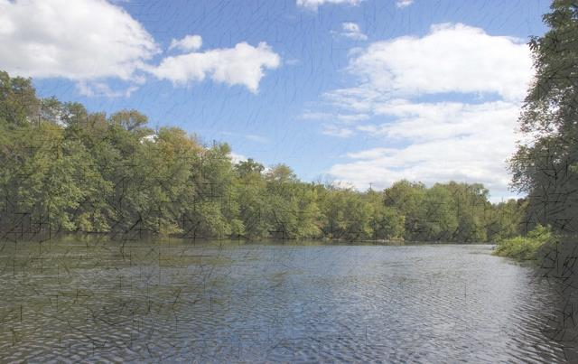
Silver Spring Township
Suburban Serenity with
Urban Proximity

Slide 2
1724 – James Silver (Scots-Irish decent) first comes to the Silver Spring Township area – originally known as Pennsborough Township, Lancaster County. The area was also called the North Valley.
By 1727 several more Scots-Irish have come to the North Valley and by 1735 there were several settlements from the west bank of the Susquehanna River to the Maryland line.
Blunston License – 1735
Road from the Susquehanna River through the North Valley
Indians vs. Settlers
Silver Spring Presbyterian Church
Villages of Silver Spring Township

Slide 3
Notes:
When James Silver saw the spring where the Silver Spring Presbyterian Church is now located he knew it was the ideal place to settle with his family. This sketch was done by Ted Baldwin for the church.

Slide 4
Notes:
Map of Hogestown from the mid 1800s

Slide 5
Notes:
The Hoge Tavern Built by David Hoge in 1794 from limestone found in the area. The tavern had many owners and is located on the east end of Hogestown. It was the first building travelers saw coming from Harrisburg to Carlisle. I
In 1805, tavern keeper, Jonathan Hoge assaulted John Moser, Sr. over a bar tab and he was later indicted for assault and battery. The tavern was known as the Sign of the Bear and Sign of the Buck. In 1909, Walter Mahan owned the tavern where he served Dowhney Lager Beer made in Lemoyne.

Slide 6
Notes:
Here the tavern is during World War I and was owned by Walter Rohland. He used the tavern as a general store and living area. Where the red arrow shows the location of a Red Cross poster letting residents know that at this location they can make donations to the Red Cross, which went towards supporting the World War I troops.

Slide 7
Notes:
New Kingston (New Kingstown) map of the mid 1800s

Slide 8
Notes:
The Tremont House – In 1790, Benjamin Junkin built this. It has served as an inn and tavern and was known as the Sign of the Lyon. Today it is a private residence.

Slide 9
Notes:
Kanaga House – Location of first communion in America by the Reformed Presbyterian Church. The first part of the house was built in 1775 by Joseph Junkin. During the Confederate invasion to the Cumberland Valley in 1863 Confederates camp on the grounds.

Slide 10
Notes:
Silver Spring Presbyterian Church and its cemetery are significant to Silver Spring Township. The church is located on the orginal location of the log church that was built by the Scots-Irish in 1775. the builders of this church, known as the “Meiting House, were referred to as “the people over the Susquehanna.” In 1929, The church underwent a major renovation and was restored to it’s original look in 1775. Renovations were hand done as it was during its original period.

Slide 11
Notes:
Farming was an important occupation for Silver Spring Township. A farm’s success depended on the weather, insects, diseases, and the prices of crops and livestock.

Slide 12
Notes:
The Hogestown Stock Show started in June 1905 by Vance McCormick and other farmers in the area. The major purpose of the show was to bring together farmers in Silver Spring township and teach them ways to improve their crops and their livestock. The show was held yearly at Big Head Woods off the Hogestown Road. The show ran for three days. Farmers would also register their livestock and crops to compete in various competitions. Women could enter baked goods and children would enter produce.
During WWI the show was put on hold in order for farmers to support the troops by producing crops that would be sent overseas to help feed the troops. After the war the show attempted to start again but there was little interest. On June 22, 1922 the stock show closed for good.

Slide 13
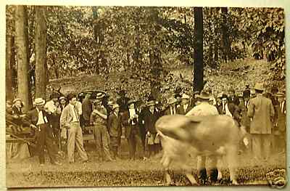

Slide 15
Notes:
Various farmers who supported the stock show.

Slide 16
Notes:
Lime Kiln along Willow Mill Park Road. Stone was dumped into the top of the kiln, below which was a wood fire. The heat would draw the lime from the stone, causing the lime to fall to the bottom. The stone was converted to dust. It was used as mortar and fertilizer.

Slide 17
Notes:
The PA State Highway Department (Today’s PennDot) owned the limestone quarry in Hogestown. Here limestone would be crushed, loaded on trucks and distributed throughout the area to make roads. In September 1920, the quarry blasted 2,000 pounds of atlas powder, the biggest blast of that time. The blast turned out 20,000 tons of stone.

Slide 18
Notes:
In 1936, under the President Roosevelt’s Work Progress Administration the road through Hogestown (the Carlisle Pike) was built.

Slide 19
Notes:
Trains were essential for to the locals whether it was for the trains to move grain or produce for farmers and businesses or for locals to get to Chambersburg, Harrisburg or Philadelphia. The train made regular stops in New Kingstown.

Slide 20
Notes:
Wilson/Taylor Airport located in New Kingstown and was first established by J. Frank Wilson. During World War II the airport was used for Civilian Pilot Training. The trainees were required to enlist in the Army or Navy Reserves. This gave them the opportunity to serve their country and also to have a career as a pilot once their service was over.

Slide 21
Notes:
The Huston Mill aka Willow Mill sits along the Conodoguinet Creek at Willow Mill Park. It was built in the late 1700s by John Walker.
In 1929, Raymond Dewalt, inventer of the radial saw, purchased Willow Mill after selling his patton. The Willow Mill Inn had 20 rooms that included a dining area and bedrooms where vistitors could stay overnight. It had 12 fireplaces. The Inn was originally built by Senator Booker from Virginia.

Slide 22
Notes:
Menu from the Willow Mill Inn. Favorite dish was Chicken and waffles. Meals would cost around $2.50. Meatless entrees were $1.25.

Slide 23
Notes:
Boating and swimming were popular activities at Willow Mill.

Slide 24
Notes:
Silver Spring Speedway was a major attraction locally and throughout South Central PA.

Slide 25
Notes:
Silver Spring Speedway, Flea Market, and drive in. location of Kohls.

Slide 26
Notable people who Lived, vacationed & passed through
Silver Spring Township
George Croghan
George Washington
Vance McCormick
Jane Deeter Rippen & Jasper Deeter
Boas Family
Raymond DeWalt

Slide 27
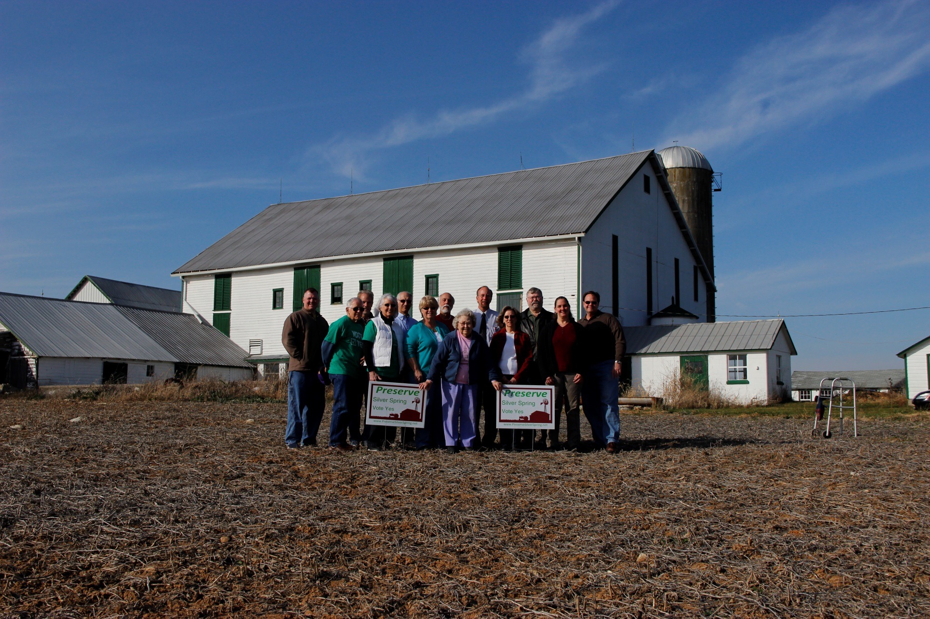
Mary Deitch Farm – First farm in Silver Spring Township to be saved through the Cumberland County’s Agricultural Conservation Easement Purchase Program.

